Slide 1
Office of Logistics and Acquisition Operations (OLAO)
Acquisition Management Committee (AMC)
October 25, 2022

Slide 2
OLAO Overview
The Office of Logistics and Acquisition Operations (OLAO), within the Office of the Director (OD) of the National Institutes of Health (NIH), the preeminent 'go-to' provider of quality acquisition and logistics services to enable federal agencies to accomplish their missions by providing customized solutions.
Consists of the following:
  Division of Logistics Services
  Office of Acquisitions
  NITAAC
  Category Management & Strategic Sourcing

Slide 3
Mission Statement
The OLAO, Office of Acquisitions produces high-quality value-added acquisition solutions, by collaborating with customers to create economies of scale to be leveraged for customer-focused mission support.

Slide 4







OLAO-OA Vision Guidepost
1. We perform high quality contracting actions faster than other contracting organizations.
2. We perform our work with a high degree of integrity and transparency.
3. We bring innovation into our work to create efficiencies and improve effectiveness.
4. We have streamlined processes through automation.
5. We are seen as advisors.
6. We collaborate across teams, sharing information and lessons learned.
7. We are engaged and promote OLAO as a good place to work.

Slide 5
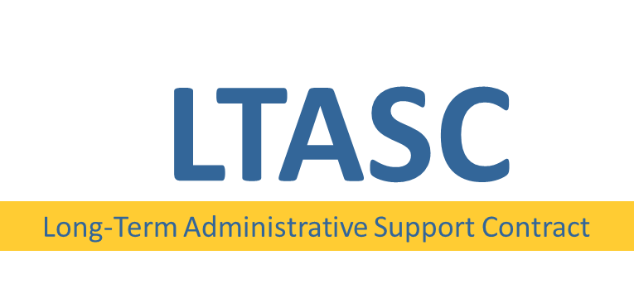



NIH Wide Contract Vehicles
Comprehensive portfolio of services
Lessons learned shared between contracts
Standard task order process
Uniform contract websites
Consistent customer experience
Available tools and templates
Helpful support team

Slide 6
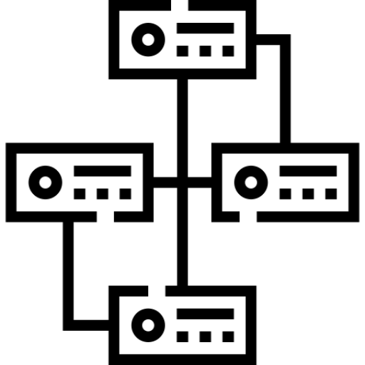


Long-Term Administrative Support Contract
LTASC provides all of NIH a mechanism to acquire long-term administrative support services for a period of at least twelve months on a task order basis.
BENEFITS OF USING LTASC
  Offers a management infrastructure to support the customer.
  Satisfies part-time and full-time administrative support needs.
  Provides qualified and cost-effective personnel through competition among Contractors.
LTASC is the only means to procure long-term administrative support within NIH.
LEARN MORE: https://ltasc.od.nih.gov

Slide 7


NIH Business and Profession Support Services
NIHBPSS provides a wide range of business and professional support services across multiple task areas to NIH and HHS.
BENEFITS OF USING NIHBPSS
  We brainstormed with the best and the brightest of the NIH community to create this contract in order to increase effectiveness and usability – we listened to your needs.
  We work with you on your acquisition timeline from release of the requirement to proposal deadline – so that your schedule is taken into consideration when making an award.
NIHBPSS allows you to have a portfolio of services at your fingertips.
LEARN MORE: https://nihbpss.olao.od.nih.gov

Slide 8


NIH Conference, Administrative and Travel Services
NIHCATS provides a wide range of conference, meeting, administrative, and travel support services to NIH, HHS, and other Federal agencies.
BENEFITS OF USING NIHCATS
  Flexible enough to support conferences both in the United States and abroad – because science happens everywhere.
  Less work for you – NIHCATS relieves the customer of the burden of executing a full contract, providing a simplified task order process.
NIHCATS is firmly established and recognized as an HHS-wide strategic sourcing initiative.
LEARN MORE: https://nihcats.olao.od.nih.gov

Slide 9

Public Information and Communication Services
PICS provides high quality performance in the areas of media, communication, information dissemination, and information technology to all of NIH.
BENEFITS OF USING PICS
  Tired of creating everything from scratch? PICS relieves the customer of the burden of executing a full contract, providing a simplified task order process.
  Let us make your experience better - not only do you receive expertise in communication goods and services, but you can also fulfill your NIH Small Business requirement.
PICS was designed in conjunction with the communications community.
LEARN MORE: https://pics.olao.od.nih.gov

Slide 10
Current Status of NIH-wide Contract Vehicles
LTASC III
  Awarded August 2022
  Performing voluntary corrective actions
NIHBPSS III
  Awarded August 2022
  Available for new awards
NIHCATS III
  Ends July 2023
  Currently in acquisition planning for NIHCATS IV
PICS II
  Ends December 2023
  Currently in acquisition planning for PICS III

Slide 11
LTASC Transition
The government received four protests
(2 agency level and 2 GAO level) which have all been dismissed as of September 22, 2022.
However, the government has decided to take corrective actions to review the technical evaluation results.
LTASC III awarded
on August 1, 2022,
to twelve (12) small businesses.
We expect LTASC III to be
up and running on about
November 15, 2022.
During the period of revisiting the technical evaluation results, there will be no break in services. LTASC II contracts are available to meet customer needs. Customers may compete new task orders or recompete existing task orders for one base year.

Slide 12
Contact Us
  Brian Goodger, OLAO Associate Director Brian.Goodger@nih.gov
  Darnese M. Wilkerson, OLAO-OA Director, Darnese.Wilkerson@nih.gov
  Terita Stevenson, OLAO-OA Strategic Contracting Branch Chief, stevenst@od.nih.gov
  NIH-Wide Vehicle Contact Information
  LTASC III Email: LTASCIII@mail.nih.gov
  NIHBPSS III Email: NIHBPSSIII@mail.nih.gov
  NIHCATS III Email: NIHCATSIII@mail.nih.gov
  PICS II Email: PICSII@mail.nih.gov

