Slide 1

Navigating the national institutes of health (NIH)
Annette V. Owens-Scarboro
Small Business and Historically Black Colleges and Universities/ Minority Serving Institutions Program Manager
Notes:
NIH has external support to build the capacity of the PEI Initiative to be a successful contracting competitiveness incubator for HBCUs.
NIH is out front among other Federal agencies participating in the White House Initiative on HBCUs.
The PEI Initiative consistently hosts a Federal HBCU Industry Day and other activities during the Annual HBCU Week Conference, and the Chairman of President Biden’s Advisory Board for HBCUs is the President of Delaware State University, a participant in the PEI 2.0 Cohort.

Slide 2
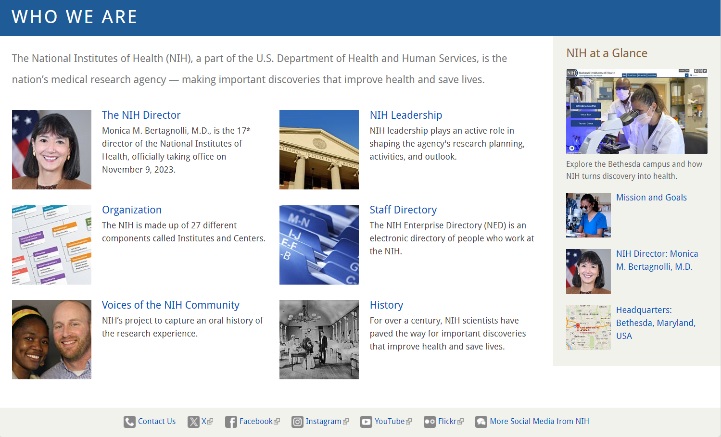
Who Are We? The nih!
NIH is the steward of medical and behavioral research for the Nation. Its mission is to seek fundamental knowledge about the nature and behavior of living systems and the application of that knowledge to enhance health, lengthen life, and reduce illness and disability.

Slide 3
One nih, 27 Cultures
Navigating the NIH
Each IC has its own mission
Each IC has its own budget
Each IC has its own activities
Each IC has its own way of doing business

Slide 4
FY 2024 Operating budget: ~$51.1B
On March 9, 2023, President Biden submitted to Congress his FY 2024 Budget request encompassing all Federal agencies - including a proposed budget of $51.1 billion for the NIH. The overall request includes discretionary budget authority of $48.9 billion, of which $407 million is associated with 21st Century Cures Act allocations and $83 million is for Superfund research activities. Approximately $1.95 billion of the NIH total request is derived from Program Evaluation financing with another $250 million identified as mandatory resources for special type 1 Diabetes research. The NIH proposed total includes $2.5 billion in budget authority for the Advanced Research Project Agency for Health (ARPA-H). More information about the ARPA-H request can be found in the separate ARPA-H Congressional Justification.
NIH Budget Office: http://officeofbudget.od.nih.gov/index.htm

Slide 5
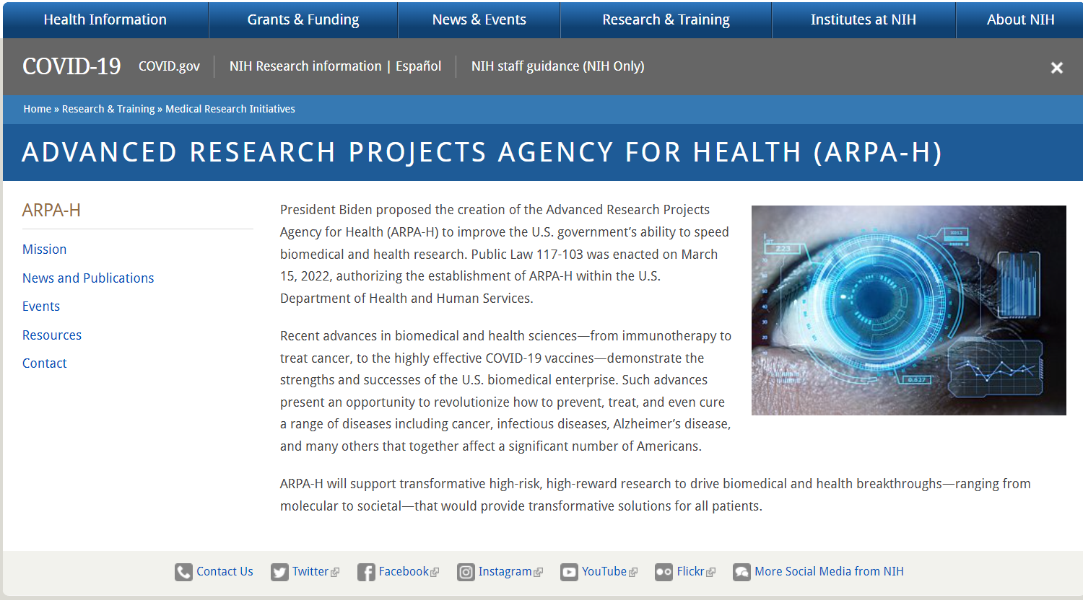
ADVANCED RESEARCH PROJects Agency for health (Arpa-h)

Slide 6
ARPA-H Organization with HHS
HHS Secretary
ARPA-H Key Features and Authorities
ARPA-H is a Federal R&D Funding Agency.
Independent component of HHS within NIH,
but not an Institute.
ARPA-H Director reports directly to HHS Secretary.
No internal research labs; disease agnostic.
Lean and nimble management structure.
Bottom-up Program Manager driven ideas and
decision-making.
Prize Authority.
Not grant-based; focus on Cooperative agreements, OTAs, contracts.
High Risk/High Impact Research.
NIH Director
ARPA-H Director
Program
Managers
Business Team Members

Slide 7
FY2023 NIH Acquisition Organization COACs Solar Chart
Clinical Center (CC)
R&D $.187M & Non-R&D $314M
Total: $314M
Susan Nsangou
National Heart Lung & Blood Institute
(NHLBI, NIAMS, CSR, NIDCR, NIBIB, NHGRI)
R&D $151M & Non-R&D $594M
Total: $745M
Allison Cristman (Acting)
National Institute on Drug Abuse
(NIDA, NINDS, NIMH, NIA, NCATS)
R&D $184M & Non-R&D $695M
Total: $879M
Christopher Belt
Clinical Center (CC)
R&D $.187M & Non-R&D $314M
Total: $314M
Susan Nsangou
NATIONAL INSTITUTES OF HEALTH
OFFICE OF ACQUISITION AND LOGISTICS MANAGEMENT (OALM)
Diane J. Frasier
Head of the Contracting Activity, NIH
Total: $8.32B
COAC: R&D Contracts: $2.51B & Non-R&D Contracts: $5.37B
DELEGATED: Purchase Card: $299M; Delivery/Task Orders: $76M; Purchase Orders: $21M; BPA Calls: $46M
National Cancer Institute
(NCI, NCCIH)
R&D $1.38B & Non-R&D $349M
Total: $1.73B
Francine Hemphill
NATIONAL INSTITUTES OF HEALTH
OFFICE OF ACQUISITION AND LOGISTICS MANAGEMENT (OALM)
Diane J. Frasier
Head of the Contracting Activity, NIH
Total: $8.32B
COAC: R&D Contracts: $2.51B & Non-R&D Contracts: $5.37B
DELEGATED: Purchase Card: $298M; Delivery/Task Orders: $76M; Purchase Orders: $21M; BPA Calls: $46M
National Institute of Environmental Health Sciences (NIEHS)
R&D $99M & Non-R&D $73M
Total: $172M
Melissa Gentry
National Cancer Institute
(NCI, NCCIH)
R&D $1.38B & Non-R&D $349M
Total: $1.73B
Wanda Neal (Acting)
National Institute of Allergy & Infectious Diseases
(NIAID, HHS Biodefense)
R&D $603M & Non-R&D $314M
Total: $917M
George Kennedy
National Library of Medicine
(NLM, CIT, OD)
R&D $.054M & Non-R&D $656M
Total: $656M
Dan Hartinger
National Institute of Allergy & Infectious Diseases
(NIAID, HHS Biodefense)
R&D $603M & Non-R&D $314M
Total: $917M
George Kennedy
Office of Logistics & Acquisition Operations
(OLAO, NINR, NEI, ORS, NIDCD, NIGMS,
OD, NITAAC)
R&D $.755M & Non-R&D $970M
Total: $971M
Darnese Wilkerson
NITAAC: $356M
Brian Goodger
National Institute of Child Health & Human Development
(NICHD, NIAAA, FIC, NIDDK, NIMHD, OER (NIH-OD))
R&D $87M & Non-R&D $296M
Total: $383M
Marlene Mireles
Office of Research Facilities (ORF)
All NIH Facilities Related to Acquisitions
R&D $2.6M & Non-R&D $752M
Total: $755M
Kala Shankar

Slide 8
FY2023 COAC Breakdown of Solar Chart
COACs | IC Customers | R&D Total Obligations | Non-R&D Total Obligations | TOTAL R&D and Non-R&D
CC | CC | $.187M | $314M | $314M
NCI | NCI and NCCIH | $1.384B | $349M | $1.73B
NHLBI | NHLBI, CSR, NIAMS, NIDCR, NIBIB, and NHGRI | $151M | $594M | $745M
NIAID | NIAID, and HHS BIODEFENSE | $603M | $314M | $917M
NICHD | NICHD, NIAAA, FIC, NIDDK, NIMHD, and OER (NIH-OD) | $87M | $296M | $383M
NIDA | NIDA, NINDS, NIMH, NIA, and NCATS | $184M | $695M | $879M
NIEHS | NIEHS | $99M | $73M | $172M
NLM | NLM, CIT, NIH-OD | $.054M | $656M | $656M
OLAO - NITAAC | OLAO [NITAAC: Services all NIH & OLAO: NIH-Wide Vehicle Branch], NEI, NIDCD, NIGMS, ORS, NIH-OD, and NINR | $.755M $0M | $970M $356M | $971M $356M
ORF - *ORF-Lease | ORF and ALL NIH FACILITIES RELATED ACQUISITIONS | $2.6M | $752M | $755M
Head of the Contracting Activity (HCA) – Total $8.32B:
  COAC $7,88B (R&D $2.51B; Non-R&D $5.37B)
COAC & DoA P-CARDS $298M (includes credits)
DoA $143M (DO/TOs $76M + POs $21M + BPA Calls $46M)
Note: *ORF Leases (PSC X1**) $82M (This figure is included in the ORF Non-R&D Total of $752)

Slide 9

Services Procured by NIH
  Consulting
  Studies
  Conferences
  Training
  Planning
  Technical Assistance
  Clearinghouse
  Data Collection/Analysis
  Logistical and Management Support
  Evaluations
  Biomedical Research
  Public Awareness Programs

Slide 10
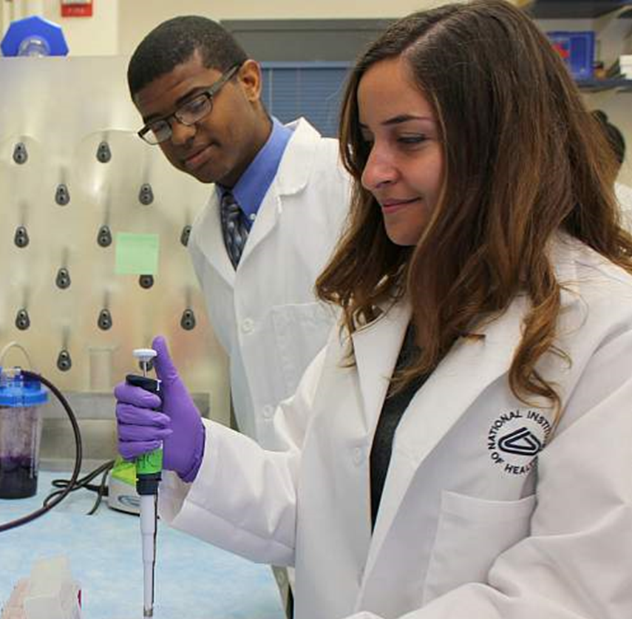
Research and development
  Most of the contract obligations
  stem from:
  Clinical Trials
  Pharmacological studies
  Genetics and Biology
  Investigations
  Vaccine Development and Testing
  Environmental Research

Slide 11
Nih Off-site locations
Montgomery County, Maryland (MD) facilities
NIAID-IRF and Frederick National Laboratories (NCI) at Frederick, MD
Bayview Research Center, MD (John Hopkins Hospital)
Rocky Mountain Laboratories, Montana (MO)
NIEHS (RTP), Durham, North Carolina (NC)
NIDDK-Phoenix, Arizona
NHLBI Framingham Heart Study, Framingham, MA
NICHD-Detroit, Michigan

Slide 12

Examples of Acquisition Vehicles

Slide 13
NIH Information Technology Acquisition & Assessment Center (NITAAC):
https://nitaac.nih.gov/
CIO-SP3
Everything IT!
Services and Solutions Across
10 Task Areas
1. IT Services for Biomedical Research Health Science & Healthcare
2. Chief Information Officer (CIO) Support
3. Imaging
4. Outsourcing
5. IT Operations and Maintenance
6. Integration Services
7. Critical Infrastructure Protection and Information Assurance
8. Digital Government
9. Enterprise Resource Planning
10. Software Development
53 Contract Holders
Large & Small Businesses
Eligible in All 10 Task Areas
NCAF 0.65% ($150K Annual Cap)
Orders Range From $50K-$700M
CIO-SP3 Small Business
153 Contract Holders
Small & Large Businesses
Not Eligible in All 10 Task Areas
NCAF 0.55% ($150K Annual Cap)
Orders Range from $15K-$400M
5 Socioeconomic Categories*
* Note: Recently added new SDVOSB and HUBZone contract holders
For updates regarding CIO-SP4 click here!

Slide 14
Nih Supporting acquisition vehicles
Simplified Acquisition & Micro-Purchase Threshold:
https://www.acquisition.gov/far/part-2
NIH Purchase Card:
https://oamp.od.nih.gov/dsaps/guides-policies-procedures
NIH Blanket Purchase Agreement:
https://oamp.od.nih.gov/dsaps/bpa-program
BPA Program Helpline: 301-496-5212
BPA Program Email: BPAProgramBranch@od.nih.gov

Slide 15
Office of Acquisition Management & Policy
Blanket Purchase Agreements Program (BPA)
Nora Rivera, Branch Chief BPA Program Office

Slide 16

BPA Program Overview
The NIH BPA Program was established in the late 1980s when it was discovered that the NIH was paying list price for most of their products and services. We are not a mandatory source.
Our goals are to:
  Negotiate discounts on behalf of NIH delegated acquisition community
  Establish BPA with vendors under FAR 13
  Assist NIH buyers with market research
  Provide quality customer service
The NIH BPA Program provides a preferred list of vendors and discount pricing with NIH specific past performance that are frequently used by the Delegated and Simplified Acquisition Community within the NIH.

Slide 17


What is a BPA?
A Blanket Purchase Agreement (BPA) is a simplified method of filling anticipated repetitive needs for supplies or services by establishing “charge accounts” with qualified sources of supply (FAR 13.303-1).
FAR 13 : A BPA is an agreement (not a contract) between the NIH and the vendor to furnish supplies and/or services to the NIH at a pre-negotiated rate.
Currently, NIH maintains over 350 Open Market (O/M) and some Federal Supply Schedule (FSS) BPAs covering a wide range of supplies and services

Slide 18


What is a BPA? (cont’d)
BPAs under FAR 13:
The agreements are charge accounts that serve to standardize pricing NIH-wide for quick buys.
The ordering period is 12 months.
There are over 59 categories that are covered under these BPAs including biological materials, chemicals, lab supplies, short-term temporary help, lab testing services, office supplies, etc.

Slide 19


Establishing an OM BPA
Open Market (O/M)
When establishing a BPA, the BPA program considers the following:
Vendor has products/services that will benefit the NIH
Vendor has past performance (within the last two years) of doing simplified orders (including purchase card) with the NIH
Vendor offers discounts against its commercial catalog.
Must be active in SAM and not on the Excluded Parties List

Slide 20
Establishing an OM BPA-Cont’d
Schedule a meeting with BPA Administrators through BPA Helpline
Completing the Application and submitting necessary documentation
Note: BPAs are no longer established with new vendors for commodities available under another NIH Strategic Source. Examples-IT, Conference Support, Communications

Slide 21

BPA Program Team
Courtney Carter, Procurement Analyst
Micole Cheatham, Procurement Analyst
Rae Mangum (C), Contract Analyst
Wilmer Sorto, Procurement Analyst
Christina Vaughan, Procurement Analyst
Nora Rivera, Program Manager/Branch Chief

Slide 22




Office of Logistics & Acquisition Operations (OLAO) NIH-WIDE VECHICLES
OLAO, Office of Acquisitions engages in NIH and HHS agency-wide mission support opportunities:
  Business and Professional Support Services contract for the support of NIH wide professional services.(NIHBPSS) – recompete in 2024
  Long-term Administrative Support Contract (LTASCIII)
  Public Information and Communication services contract for support of NIH Wide communication efforts. (PICS) – recompete in 2024
  NIH Conference, Administrative and Travel Services Contract (NIHCATS) – recompete in 2024
  Others…

Slide 23
Other contracting VECHICLES
GSA Federal Supply Schedules (FSS)
  Website: www.gsa.gov
  GSA RFQs posted on GSA E-Buy: https://www.ebuy.gsa.gov/
  GSA Advantage ordering tool used by buyers to order against GSA Schedule Contracts: https://www.gsaadvantage.gov
2023 GSA Buys
OA = $868,113,892.27 with a total of 2,507 actions
Delegated = $30,360,010.53 with a total of 1,384 actions

Slide 24
Electronic bid board listing
NIH Bid Board: Notice of Proposed Contract Actions Posted in Accordance with FAR 5.101(a)(2)
The NIH electronic Bid Board is a new online bid board developed to increase competition and awareness for proposed contract actions expected to exceed $15,000 but not expected to exceed a $25,000 acquisition threshold.
National Cancer Institute (NCI): https://www.cancer.gov/about-nci/contracts/opportunities/bidboard
National Institute on Drug Abuse (NIDA): https://nida.nih.gov/funding/nida-office-acquisitions-contracting#Bidboard
National Institute of Environmental Health Sciences (NIEHS): https://www.niehs.nih.gov/about/orgchart/om/oa/bidboard/index.cfm
National Library of Medicine (NLM): https://www.nlm.nih.gov/oam/curbusopp.html
Office of Research Facilities Development & Operations (ORF): https://orf.od.nih.gov/Acquisitions/AEContracting/Pages/ORF-Bid-Board.aspx
Bid Board Link: National Institutes of Health (NIH)

Slide 25


Slide 26
Who Should I talk to? When? And About What?
NIH People
Program Officer
Scientific Review Officer
Grants Management Officer
Before applying discuss
  Concept paper aims & fit with NIH priorities
  Appropriate funding mechanism
  Responsiveness to review criteria
  After Review to discuss next steps
After application is assigned to a review committee until review is complete to discuss:
  Review committee selection
  Missing info
  Supplemental info
Before or after review to discuss:
  NIH grants policy
  Budget
  Change of institutions
  Grant start dates

Slide 27
Examples of funding mechanisms
 | Federal Grants | Federal Cooperative Agreement | Federal Contracts
Basic Purpose | A flexible instrument designed to provide money to support a public purpose. Assistance with few restrictions. | A flexible instrument designed to provide money to support a public purpose. Assistance with involvement between parties. | A binding agreement between a buyer and a seller to provide goods or services in return for consideration (usually monetary). Procures goods or services.
Terms & Conditions | Governed by the terms of the grant agreement | Governed by the terms of the cooperative agreement | Governed by Federal Acquisition Regulations
Scope | Conceived by PI. Flexible as to scope of work, budget, and other changes | Conceived by PI. Typically flexible as to scope of work, budget, and other changes | Conceived by sponsor. Relatively inflexible as to scope of work, budget, and other changes
Solicitation | Application kit or guidelines | Request for application | Request for proposal or quote
Effort | Diligent efforts are used in completing research and the delivery of results | Diligent efforts are used in completing research and the delivery of results | Significant emphasis placed on delivery of results, product, or performance
Sponsor Involvement | None | Substantial involvement | Approves activity, expects results
Payment | Payment awarded in annual lump sum | Payment awarded in annual lump sum unless otherwise specified in the cooperative agreement | Payment based on deliverables and milestones
Re‐ budgeting | Flexible | Usually flexible | More restrictive
Reporting | Annual reporting requirements | Reporting requirements determined by the cooperative agreement | Frequent reporting requirements
Flexibility | Principal Investigator has more freedom to adapt the project and less responsibility to produce results | Substantial involvement is expected between the executive agency and the State, local government, or other recipient when carrying out the activity contemplated in the agreement. | High level of responsibility to the sponsor for the conduct of the project and production of results

Slide 28
Phases of Acquisition
Process (Sample)
Acquisition Planning (AP)/ Acquisition Strategy (AS)
RFP/Solicitation
Contract Administration
Determine a Need
• Identify service/product desired
2 Assemble Acquisition Team
        • PO, CO, CS, AO, OGC, program team
3 Draft Statement of Work
    • Salient Characteristics
    • Deliverables
    • Delivery Schedule
    • Special Requirements,
    • Mandatory & Standard Evaluation Criteria
    • Technical Proposal Instructions
4 Develop an Acquisition Plan (AP/AS)
    • Identify Sources
    • Conduct Market Research
    • Construct IGCE
    • Availability of Commercial Item
    • Competition Method (RFP)
    • Select contract type (FP/CR)
    • Select TEP members
    • Other issues (warranty/options)
5 Meet with Acquisition Team to review Draft SOW & Draft AP/AS
    • Make corrections
Finalize SOW & Acquisition Plan
Present Final SOW and Final AP/AS to the Contracting Officer
1 Draft and Post Final Synopsis
    • FedBizOpps.gov
2 CO drafts and finalizes RFP for internal review
3 Post Solicitation/RFP (request for proposal)
    • FedBizOpps.gov
4 Answer Questions submitted by Potential Offerors
5 All Communication goes through the Contracting Officer
6 Amend solicitation/RFP
7 Receive & Record Proposals
8 Distribute Proposals to TEP Team
9 CO reviews business proposals and begins cost and price analysis
10 Hold TEP
    • Score Proposals to evaluation criteria
    • Develop technical score
    • Vote acceptable/Unacceptable
    • TEP report to CO
11 Determine Competitive Range
12 Submit Questions to Offerors in Competitive Range. Notify those excluded. May conduct debriefings.
13 Review Answers to Questions
14 Negotiate, win-win solution
15 Might need a revised proposal
16 Request and Receive Final Proposal Revisions (FPR)
17 Make a Source Selection
18 Award Contract
1 Copy of Contract to Contracting Officer Representative (COR)
    • Highlight PO duties
2 Post Award Kick-Off Meeting
3 Read & Review Monthly Progress Reports
4 Inspect and Accept Product or Service
5 COR reports issues/concerns/problems to Contracting Officer
6 Execute Contract Modifications
    • Unilateral or Bilateral
    • Exercise options
7 Review & Approve Invoices
8 Maintain Deliverables of Contractor
9 Perform Site-visits to Contractor
10 Perform Annual Evaluation of Contractor’s Performance
11 Assist in Contract Closeout
* On average Contracts have a period of performance of 5 years
* Some have 1 base year + up to 4 option years (could have between
2–5 years total)

Slide 29
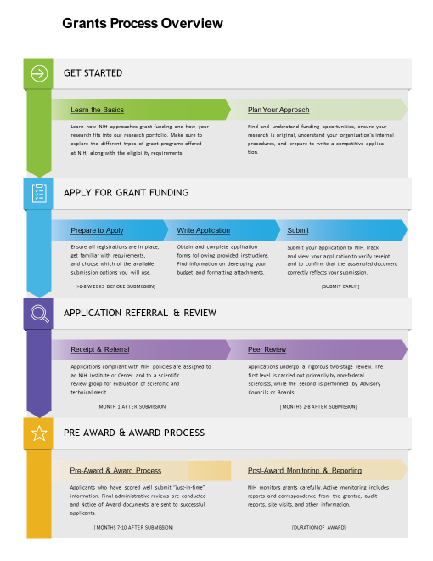
Grant process overview
https://grants.nih.gov/grants/grants_process.htm

Slide 30
NIH Small Business Program Office vs.
NIH Small Business Education and entrepreneurial development (SEED) Office
NIH Small Business Program Office
-Small Business Act of 1953
Federal Acquisition Regulation pt.19
-Assists small businesses with acquisition concerns
-Advocates on behalf of small businesses to the NIH acquisition community
-Hosts vendor outreach forums, small business industry days, and newbie open forums.
NIH SEED Office
-SBIR/STTR Reauthorization as part of S.2943, the 2017 National Defense Authorization Act (NDAA)
-Coordinates the Small Business Innovation Research (SBIR) and Small Business Technology Transfer (STTR) programs across HHS (NIH, CDC, FDA, and ACL), backing over 1,500 companies each year with more than $1.2 billion in non-dilutive awards.
- Supports entrepreneurial education and training for academic and small business innovators through the Proof of Concept Network, I-Corps at NIH, and other programs.
- Offers product development support and mentorship to innovators and NIH staff by teaming with experts in business and commercialization.
-Hosts the annual HHS SBIR/STTR Conference
Contact us at SEEDinfo@nih.gov
-Located in NIH, Office of the Director
-Works with small businesses

Slide 31
NIH FY2023 Small Business Achievements
Notes:
NIH (as a whole) did not meet any of its SB goals for FY2022.

Slide 32
NIH FY2023 Top 10 Large Vendors
Vendor Name | Total Obligations
LEIDOS BIOMEDICAL RESEARCH, INC.* | $ 1B
KELLY SERVICES, INC. | $ 201M
NATIONAL COLLEGIATE INVENTORS & INNOVATORS ALLIANCE, INC. | $ 195M
DELOITTE CONSULTING LLP | $ 187M
BOOZ ALLEN HAMILTON INC. | $ 156M
MEDICAL SCIENCE & COMPUTING, LLC | $ 136M
LEIDOS, INC. | $ 125M
GENERAL DYNAMICS INFORMATION TECHNOLOGY, INC. | $ 115M
ICF INCORPORATED, L.L.C. | $ 95M
WESTAT, INC. | $ 89M
Vendor Name | Total Obligations
AXLE INFORMATICS, LLC | $ 159M
GROVE RESOURCE SOLUTIONS, INC. | $ 82M
BLACK CANYON CONSULTING LLC | $ 80M
FORS MARSH GROUP LLC | $ 71M
OLGOONIK ENTERPRISES, LLC | $ 45M
TECHNICAL RESOURCES INC | $ 44M
THUNDERCAT TECHNOLOGY, LLC | $ 42M
LCG SYSTEMS LLC | $ 39M
HIGHRISE CONSULTING | $ 37M
OLGOONIK GENERAL, LLC | $ 36M
NIH FY2023 Top 10 Small Vendors
Total obligations include awards made by COAC and DoA for Large/Small Businesses only, R&D and Non-R&D: DCAs, IDCs, DO/TOs, POs, BPA Setups, BPA Calls, and P-Card Transactions over the Micropurchase Threshold. *Formerly SAIC Frederick, Inc.
Data derived from the SAM Standard Small Business Goaling Report.

Slide 33
NIH HUBZone CONSORTIUM
42 members
The NIH Historically Underutilized Business Zone Consortium was established to assist the National Institutes of Health in reaching, and exceeding, the 3% HUBZone goal for Small Business Procurements.
The NIH HUBZone Consortium is a group of certified companies committed to developing a common understanding of the capabilities that HUBZone firms can offer to achieve the NIH’s mission in enhancing the health for all Americans.
For more information about the NIH HUBZone Consortium please click here!

Slide 34
Historically Black Colleges and Universities (HBCUs) and Minority Serving Institutions (MSIs)
“Why HBCUs/MSIs Pursue Federal Opportunities?”

Slide 35

Executive Order 14041: White House Initiative on Advancing Educational Equity, Excellence, and Economic Opportunity Through Historically Black Colleges and Universities
Federal agencies are tasked with the following:
(C) working to break down barriers and expand pathways for HBCUs to access Federal funding and programs, particularly in areas of research and development, innovation, and financial and other support to students;
(D) strengthening the capacity of HBCUs to participate in Federal programs, access Federal resources, including grants and procurement opportunities, and partner with Federal agencies
Dr. Dietra Trent is the current Executive Director for the WHIHBCUs

Slide 36


IMPLEMENTED HBCU POLICLIES
FAR Part 26 - Other Socioeconomic Programs
FAR subpart 26.3 implements Executive Order12928 of September 16,1994,
which promotes participation of Historically Black Colleges and Universities
(HBCUs) and Minority Institutions (MIs) in Federal procurement.
Work with OMB Office of Federal Procurement Policy
The Office of Federal Procurement Policy (OFPP) in the Office of Management and Budget (OMB) plays a central role in shaping the policies and practices federal agencies use to acquire the goods and services they need to carry out their responsibilities.
White House Office of Management and Budget (OMB) Memorandum M-20-28
Encourages agencies to leverage small businesses, the AbilityOne Program,
and Historically Black Colleges and Universities

Slide 37
NIH Path to Excellence and Innovation 2.0 Initiative

Slide 38
What is the PEI Initiative?
The PEI Initiative is a tremendous opportunity for the National Institutes of Health to work more collaboratively with Historically Black Colleges and Universities and Minority Serving Institutions (HBCUs/MSIs).
The mission of the PEI Initiative is to empower HBCUs/MSIs with the knowledge, resources, and skills they need to effectively and consistently compete for and win contracts from the NIH and thereby diversify revenue streams and create more research opportunities for those academic institutions. The NIH has established a 2% goal to increase HBCU/MSI dollars.
The PEI started as a pilot program in September 2014 with 6 HBCUs.
  Jackson State University
  Hampton University
  Howard University
  Morehouse School of Medicine
  Meharry Medical College
  University of Virgin Islands

Slide 39
PEI FEATURES
NIH has developed a special curriculum, The Fundamentals of Contracting. This virtual training is a 20-hour course that addresses such topics as acquisition roles and responsibilities, integrated project teams, acquisition plan elements, categories of requirements, solicitation terms and conditions, and pre-award inquiries, among an array of other subjects critical to mastering the ability to successfully navigate the acquisition life cycle.
The PEI database is the backbone of the Initiative. The database is the only federally approved portal by OMB for HBCUs. It allows HBCUs and their respective Business Partners to access NIH contract and grant opportunities consolidated within a straightforward dashboard. The tool also provides a communication platform where the HBCU or Business Partner can submit inquiries or requests for assistance to OALM staff and view OALM announcements.
The PEI Technical Assistance Center (TAC) is a comprehensive ecosystem providing professional guidance on all aspects of the acquisition life cycle that will assist HBCUs in competing for and managing acquisition opportunities with the NIH. The ecosystem will include: Building Capacity, Assisting with the PEI Database, and Leveraging Training.

Slide 40
Path to Excellence and Innovation (PEI) Initiative 2.0 Cohort
PEI 2.0 INITIATIVE COHORT
HBCUs
• Bowie State University (TIER 1)*
• Central State University (TIER 2)*
• Cheyney University (TIER 2)*
Delaware State University (TIER 1)*
• Fayetteville State University (TIER 3)*
• Florida A&M University (Sch. Nov 6)
• Howard University (TIER 1)*
• Jackson State University (TIER 1)*
Morgan State University (TIER 1)*
• Morehouse School of Medicine (TIER 1)*
North Carolina A&T University (TIER 3)*
• Texas Southern University (TIER 2)*
• University of the Virgin Islands (TIER 2)*
The schools were evaluated based on their federal contracting experience.
TIER 1: Schools are acquisition ready.
TIER 2: Schools require some minor technical assistance.
TIER 3: Schools are working closely with the NIH PEI TAC.
Small Businesses
Aurora Technical Systems, LLC
Axis Consultant Group, LLC
Axle Informatics
BETAH Associates
Capgemini Government Solutions, LLC
Data Storage Science
Edward Performance Solutions
Federal Management Systems
Global Consulting International
Hendall, Inc
High Impact Partners
Human Touch, LLC
Immersive Concepts
Intellectual Concepts
In2end Technologies, Inc
Key Concepts Knowledgebase, LLC
Longevity Consulting
Lord & Tucker Management Consultants
MetaMeta, LLC
Oak Ridge Associated Universities
Precision Healthcare
Professional Steward Services
Sage Services Group, LLC
Technuff, LLC
Williams Consulting, LLC
zSoftTech Solutions, Inc

Slide 41
FY17 – FY23 OBLIGATIONS
Fiscal Year | NIH Total Obligations | Total Obligations to Small Businesses | Percentage to Small Businesses | Total Obligations to HBCUs | Percentage to HBCUs
2017 | $5,320,833,321.03 | $1,417,546,692.49 | 26.64% | $3,449,983.00 | 0.06%
2018 | $5,265,699,477.77 | $1,547,213,485.70 | 29.38% | $2,155,978.40 | 0.04%
2019 | $5,614,297,236.53 | $1,732,748,926.67 | 30.86% | $2,470,966.00 | 0.04%
2020 | $7,369,677,941.16 | $2,339,738,412.78 | 31.75% | $2,505,090.00 | 0.03%
2021 | $7,568,116,864.96 | $2,447,800,218.36 | 32.34% | $2,617,663.00 | 0.03%
2022 | $8,512,034,558.00 | $2,611,336,298.00 | 30.68% | $3,247,305.00 | 0.04%
2023 | $8,006,001,655.36 | $2,538,519,353.38 | 31.71% | 5,307,316.90 | 0.07%
Obligations to HBCUs continue to be below 1%.

Slide 42
NIH FY2023 TOP HBCUs
Vendor Name | Total Obligations
Tougaloo College | $2,661,994.53
Jackson State University | $2,211,052.37
North Carolina Agricultural Technical State University | $124,825.00
Bowie State University | $124,000.00
Fayetteville State University | $124,000.00
Howard University | $61,445.00

Slide 43
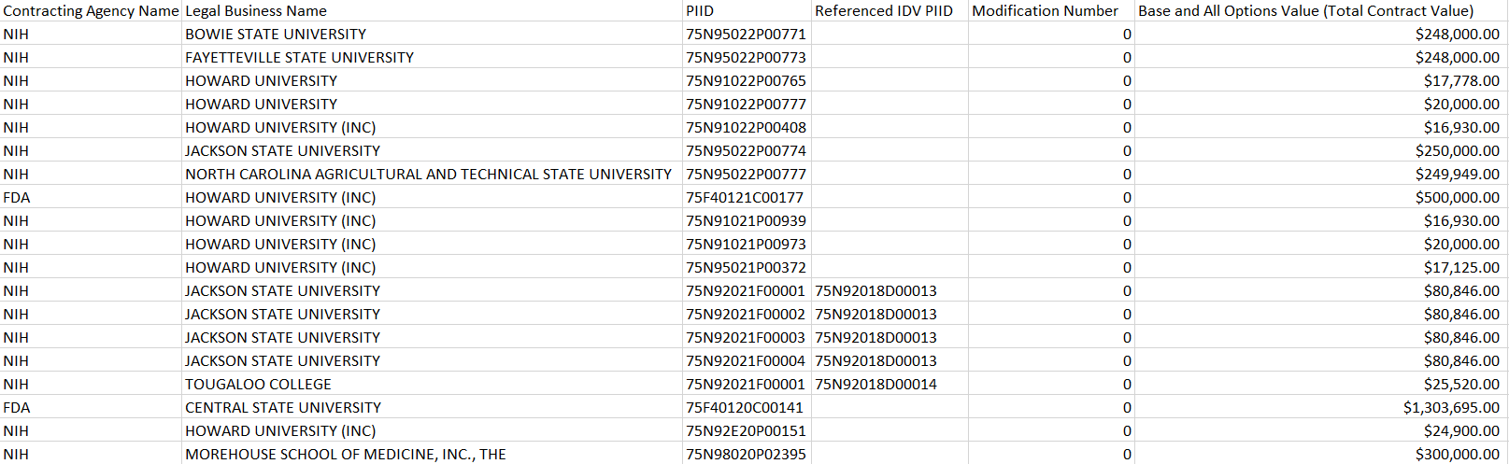
HHS HBCU CONTRACT AWARDS

Slide 44
FY2022 HBCU GRANT AWARDS
OPDIVS | Distinct Count of Awards | Record Count | Total Obligation Amount
ACF | 11 | 22 | $16,206,824.21
ACL | 15 | 36 | $3,426,695.29
AHRQ | 1 | 1 | -$10,871.78
CDC | 9 | 31 | $1,919,133.82
CMS | 1 | 1 | $0.00
DHHS/OS | 15 | 62 | $17,635,988.56
FDA | 2 | 2 | $957,280.00
HRSA | 70 | 113 | $55,595,013.34
NIH | 275 | 480 | $124,288,405.60
SAMHSA | 55 | 77 | $3,072,775.05
Grand Total | 454 | 825 | $223,091,244.09

Slide 45
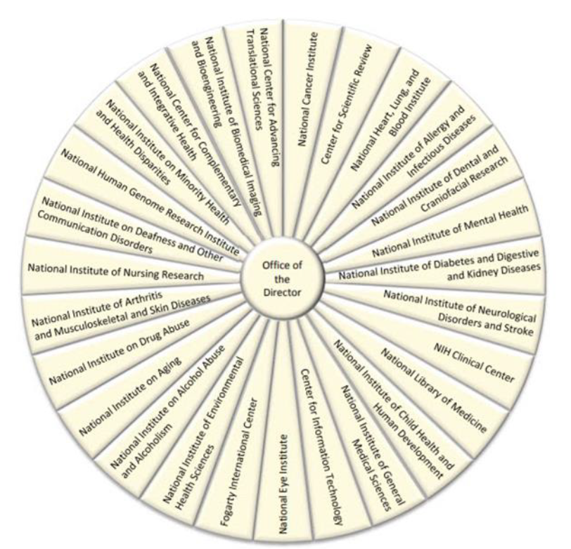
UPCOMING PEI 2.0 ENHANCEMENTS
  Community Economic Development (CED) grants. The PEI will assist schools in applying to become CDCs and in time to participate in the ACF 2024 grant cycle. Subsequently, if awarded CDC status, HBCUs may pursue 8(a) and HUBZone status under the U.S. Small Business Administration’s authority of 42 USC 9805.
  Recruit a determined number of Land Grant HBCUs including those with accredited Nutrition or Related Science Programs. There are 19 HBCUs, 4 are currently enrolled in the NIH PEI Initiative.
  Continue to provide training and support to the 13 HBCUs and 26 small businesses currently in the Cohort.
  The Advisory Committee is created for the purpose of working with the NIH SBPO to advise on matters that directly concern the NIH PEI Initiative, its goals, activities, and functioning. The Committee is formed to give advice and recommendations to the NIH PEI leadership.

Slide 46
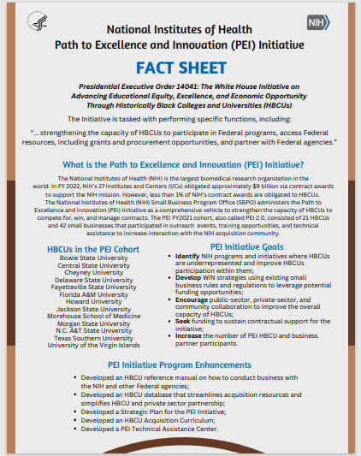




NIH PEI MARKETING MATERIALS

Slide 47
TOP 5 NIH WEB SITES TO GET YOU STARTED
NIH Home Page: http://www.nih.gov/
Office of Extramural Research Home Page: http://www.grants.nih.gov/
Center for Scientific Review: http://www.csr.nih.gov/
Research Portfolio Online Reporting Tools (RePORT): http://www.report.nih.gov/
Peer Review Process: http://www.grants.nih.gov/grants/peer_review_process.htm

Slide 48
HELPFUL RESOURCES
HHS Forecast Opportunities: https://osdbu.hhs.gov/industry/opportunity-forecast
COAC/Simplified Acquisition Listing: https://oamp.od.nih.gov/division-of-acquisition-policy-and-evaluation/acquisition-resources/acquisition-offices
Small Business Administration: https://www.sba.gov/
General Services Administration: https://www.gsa.gov/
HHS Acquisition Regulation (HHSAR): https://www.hhs.gov/grants-contracts/contracts/contract-policies-regulations/hhsar/index.html
Federal Acquisition Regulation (FAR): https://www.acquisition.gov/far/part-26
Code of Federal Regulations (CFR): https://www.ecfr.gov/
HBCUs/MSIs Inquiries: pei@nih.gov
PEI Listserv: https://list.nih.gov/cgi-bin/wa.exe?SUBED1=PATHTOEXCELLENCEANDINNOVATION&A=1

Slide 49
HHS OSDBU SUPPORT TEAM
OSDBU Director: Shannon Jackson| Shannon.Jackson@hhs.gov
OSDBU Deputy Director: Arielle Douglass| Arielle.douglass@hhs.gov
Contact with the HHS Small Business Professionals (SBPs) and introduce yourself and your company so that the SB Professionals knows your firm’s capabilities. The NIH SBPs can be reached on 301-496-9639.
Small Business Administration Procurement Center Representative: Jerome Heath| Jerome.heath@sba.gov
HHS HBCU Liaison: Kevin Diaz| kevin.diaz@hhs.gov
Anita Allen | anita.allen1@cms.hhs.gov | NIDA and NHLBI
Melanie Carter | melanie.carter@hhs.gov | NLM and ORF
Natasha Boyce | natasha.boyce@hhs.gov | CC and NICHD
Jonathan Ferguson | jonathan.ferguson@hhs.gov | NIEHS and OLAO
Amy Ulisse | amy.ulisse@hhs.gov | NCI and NIAID

Slide 50
NIH SMALL BUSINESS PROGRAM OFFICE STAFF
Annette V. Owens Scarboro
Small Business,
Historically Black Colleges and Universities/Minority Serving Institutions Program Manager
Scarbora@od.nih.gov
Keondra Watts
Program Analyst
Keondra.Watts@nih.gov
Shamya Wade
Pathways Intern
Shamya.Wade@nih.gov
Artavia Copeland
Administrative Assistant
Artavia.Copeland@nih.gov
301-496-4756
Small Business Inquires: NIHSmallBusiness@mail.nih.gov

Slide 51

Questions

